Slide 1
Adult Census Income Analysis Team 6
Lecturer: Dr. Arash Azarfar
Team members : Dina Omidvar Tehrani, Niloofar Tavakolian Nastaran Naseri, SeyedehMojdeh Haghighat Hosseini
Notes:
© Copyright PresentationGO.com – The free PowerPoint and Google Slides template library

Slide 2
Overview of the problem
Have you ever wondered what key factors could propel your income to the next level?
Income Patterns
Income Prediction
Lighting Up Inequality & Empowerment
Demographic Insights
Probing Socioeconomic Dynamics
Dissecting Adult Income Factors
2
Notes:
We are trying to Discover the answers with the enlightening insights from our Adult Census Income dataset."
we are curious to learn how 'Unlocking Income Patterns' can help us understand the factors influencing adult income levels.
Also, how 'Income Prediction' could illuminate economic inequality and foster empowerment.
Leveraging this knowledge can empower individuals economically.
And finally, how 'Demographic Insights' can unreveal the socioeconomic dynamics behind income levels?"
Income levels vary among different demographic groups, revealing challenges in our socioeconomic fabric.

Slide 3
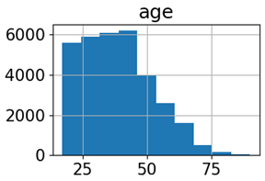
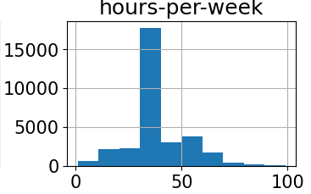
Dataset selection
Adult Census Income dataset
Kaggle(48,842 instances and 15 attributes)
target variable
indicates income level (<=50K or >50K)
Features
.
Demographic Factors
Age
Socioeconomic Factors
Education
Family and Personal Status
Marital-status
Sex
Race
Native-Country
Education-num (number of educational years completed)
Workclass
Relationship
Economic and work Factors
Occupation
Hours-per-week
Capital-gain
Capital-loss
Fnlwgt
Income
Distribution of some numerical features
Date
3
Notes:
The Adult Census Income dataset obtained from Kaggle consists of 48,842 instances and 15 attributes.
The target variable indicates income level (<=50K or >50K).
Features include demographic information, work-related factors, and socioeconomic characteristics of individuals in the United States.
the "fnlwgt" feature represents the final weight assigned to each observation in the census data. This weight is applied to ensure that the sample accurately represents the population and is a critical component in producing unbiased estimates.
Furthermore, the features "capital.gain" and "capital.loss" capture the financial gains and losses, respectively, that individuals have experienced. These features provide insights into the economic activities and investments made by individuals, which can significantly influence their overall income levels.
Here is Visualization some numerical features of the dataset using histograms to analyze the distribution of those features in the dataset.

Slide 4
Expectations and Goals
Developing a predictive model
Feature importance analysis
Evaluating model performance
Generating actionable insights
Comparing methodologies
Notes:
Developing a predictive model: Creating a machine learning model for accurate income level predictions.
Feature importance analysis: Identifying influential factors affecting income levels.
Evaluating model performance: Assessing accuracy, precision, recall, and F1-score using appropriate evaluation metrics.
Comparing methodologies: Evaluating different machine learning algorithms and deep learning approaches (e.g., CNN or RNN models) for predicting income levels.
Generating actionable insights: Informing policymakers, social scientists, and economists to address income disparities and promote economic equality.
© Copyright PresentationGO.com – The free PowerPoint and Google Slides template library

Slide 5



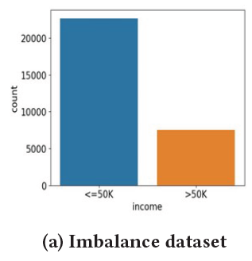
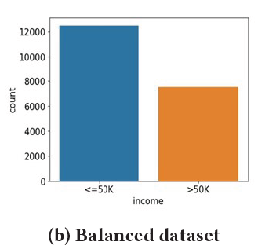
Pre-processing
Dealing with class imbalance
Handling missing values
Dealing with categorical features
5
Notes:
The challenges that we faced were:
Handling missing values: Addressing missing data using appropriate techniques. The challenge of missing values in features like workclass and occupation was addressed by removing the corresponding samples from the dataset to maintain data integrity.
Dealing with class imbalance: Handling imbalanced income classes through oversampling or undersampling. The target variable exhibited a class imbalance, with a larger number of samples having income <= $50,000. To address this, downsampling of the majority class was performed to create a more balanced dataset, improving prediction accuracy.
Dealing with categorical features in the dataset poses a challenge, and one-hot encoding was used in this study to effectively transform them into binary vectors.

Slide 6
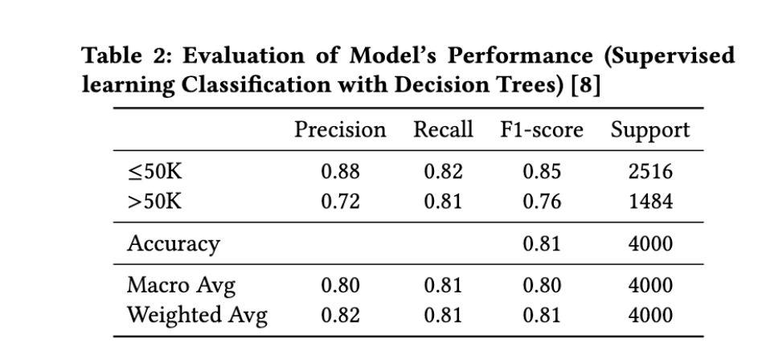
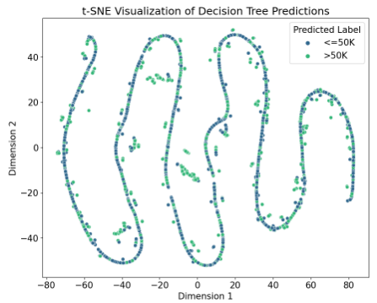
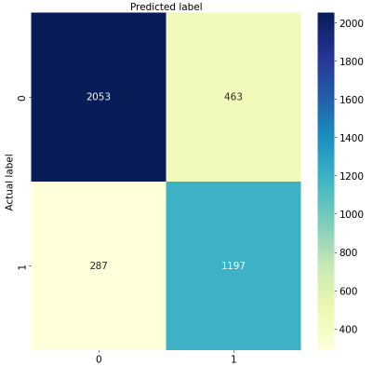
Supervised Learning: Decision Tree classification
Notes:
A Decision Tree classifier was created to predict income. The dataset was split into training, validation, and test sets (60%, 20%, and 20% respectively). Categorical variables were converted using one-hot encoding. The Decision Tree was trained with a maximum depth of 11, minimum samples per leaf of 4, and minimum samples for splitting of 2. Accuracy was calculated for the validation and test sets. Here you can see the visualization after training. The classification result is reported in the table , including precision, recall, F1-score, and overall accuracy. Also you can see the heatmap plot of the classification using Decision tree.

Slide 7
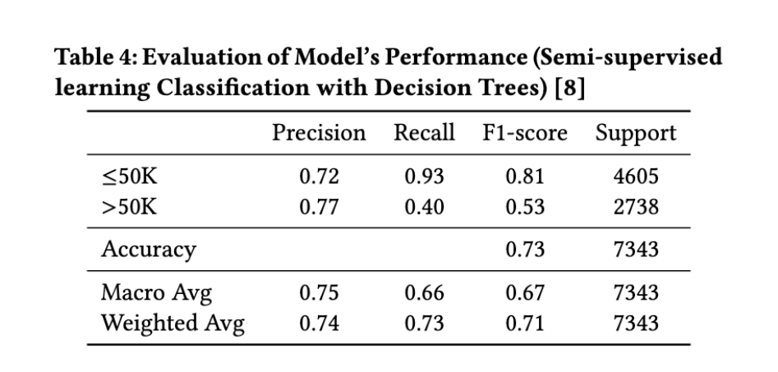
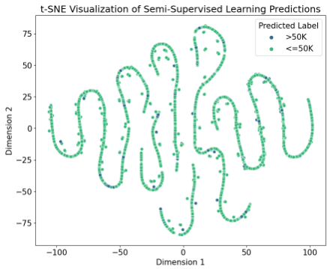
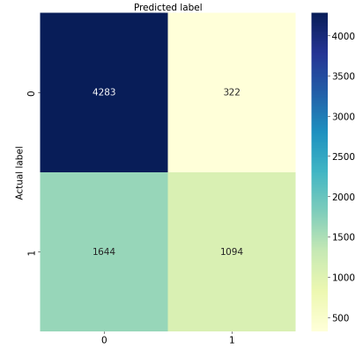
Semi-supervised Learning Using a Decision Tree Classifier
Training and Predictions on Labeled and Unlabeled Data
Probabilities for Predicted Labels
Setting Confidence Threshold
Identifying Confident Predictions
Adding Confident Predictions to Labeled Dataset
Appending Features to X_labeled
Removing Predicted Samples for Next Iteration
Calculating Accuracy of Combined Dataset
7
Notes:
we implemented a semi-supervised learning algorithm using a decision tree classifier. It starts by splitting the labeled and unlabeled datasets into features (X) and target variables (y). The labeled data is used initially to train the decision tree classifier, and the unlabeled data is used for prediction.
The code then enters a loop for a specified number of iterations.(you can see the loop in slide) In each iteration:
The decision tree is trained on the labeled data, and predictions are made on the unlabeled data.
Predicted labels are assigned probabilities using the predict_proba function.
A confidence threshold is set to determine which predictions are considered confident.
Confident predictions are identified based on the probabilities exceeding the confidence threshold.
The confident predictions, including their features and labels, are added to the labeled dataset.
The features of the confident predictions are appended to the labeled features (X_labeled).
The accuracy of the combined labeled and unlabeled dataset is calculated.
The confidently predicted samples are removed from the unlabeled dataset for the next iteration.
The purpose of this algorithm is to iteratively improve the model's accuracy by gradually incorporating confident predictions from the unlabeled data into the labeled dataset. This way, it takes advantage of both labeled and unlabeled data to train the decision tree classifier.

Slide 8
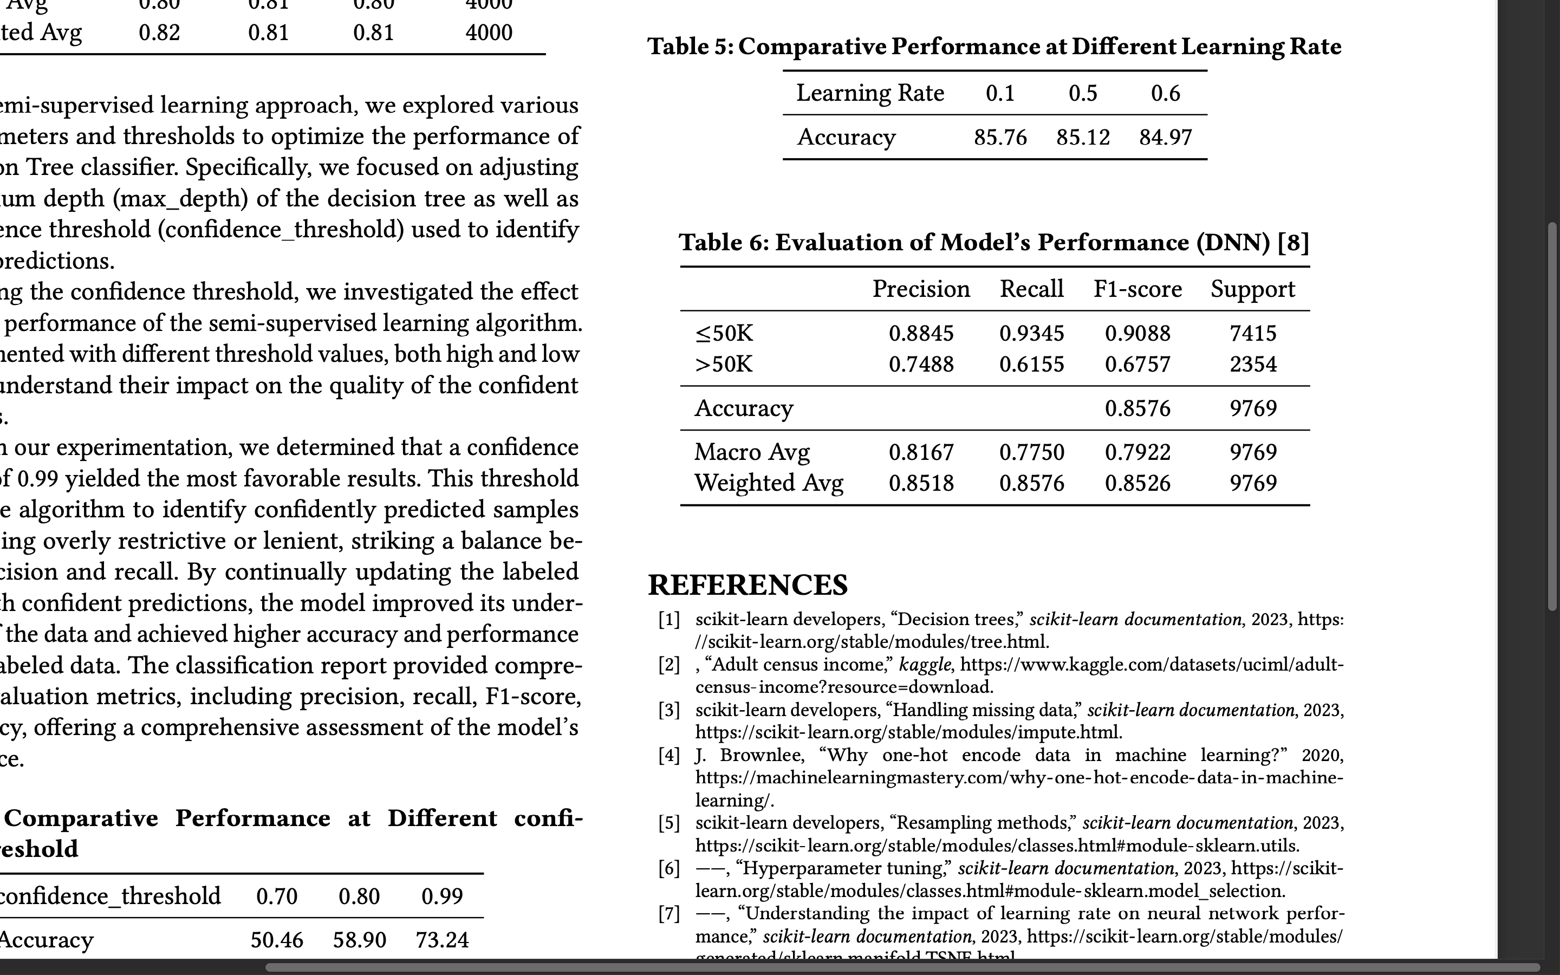
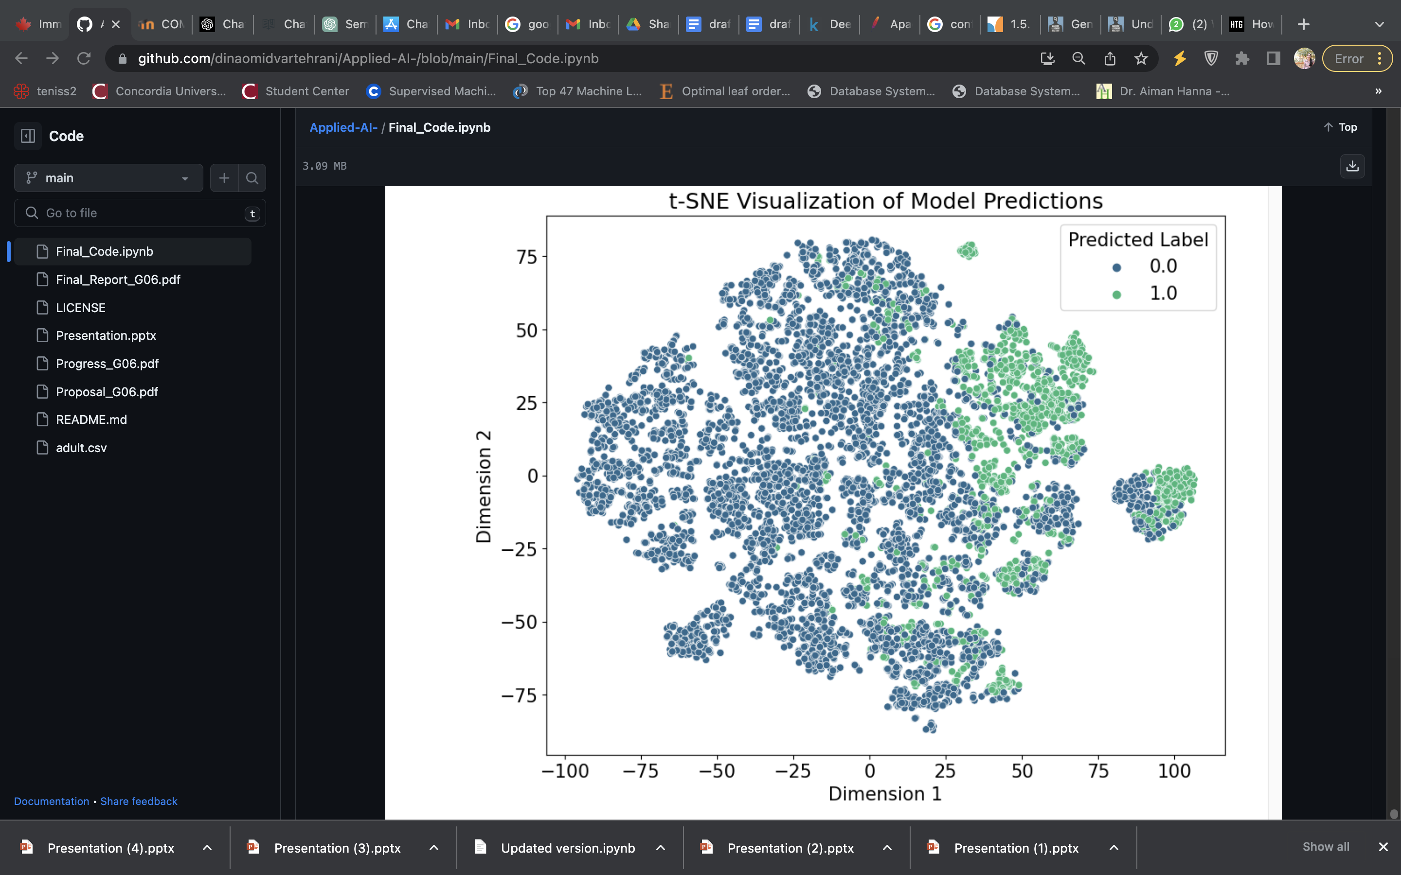
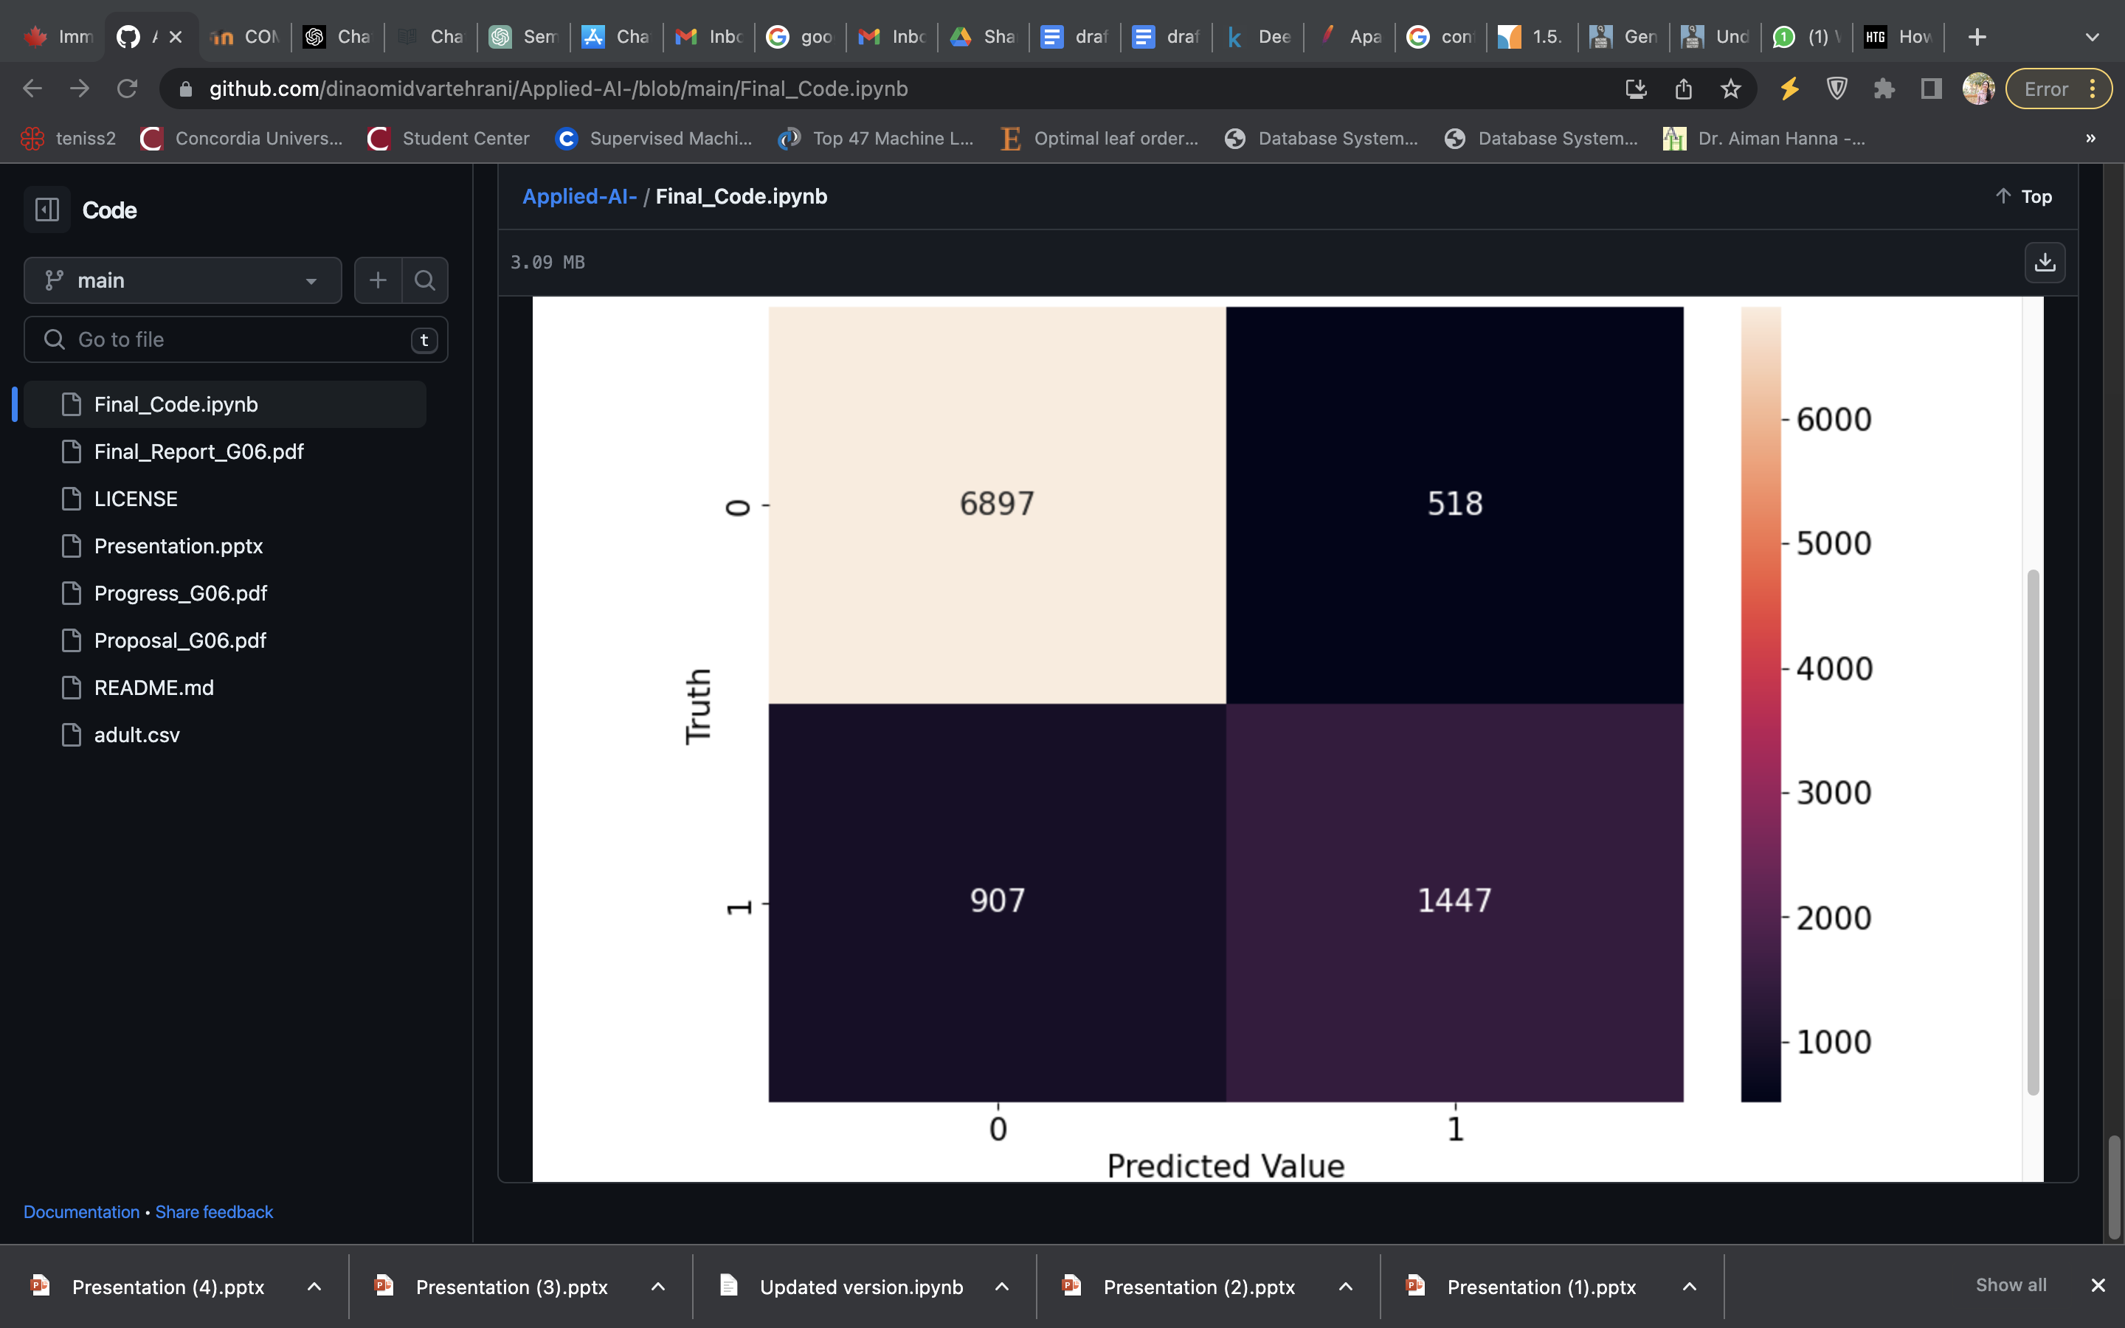
Supervised Learning: Classification with a Deep Learning Model
Activation Function
Hyper-
parameters
Layers
DNN Model Architecture
Notes:
after data pre processing : handling missing values ( replacing the characters with NaN ), encoding categorical variables ( apply label encoding to each categorical column ) and splitting into features and target variables ( test size : 0.3 ), scaling the numerical features, Fit and transform the categorical features using one-hot,
apply only label encoding to target variable, Standardization to numerical variables,
Model : classification adultCensus : 4 layers, 34 in layer1 – 128 in layer 3 – 1 out 4th
Relu
Dropout
Optimizer : SGD ; lr: 0.01 ( trial amd error )
Criterion : BCEWithLogitsLoss
Manual seeding
#epochs : 10000
-------------------------------------------------------------------------------------------------------------------------------------------
Model Architecture
The input_shape is set to (X_train.shape[1],), which corresponds to the number of features.
The first dense layer has 64 neurons and uses the ReLU (Rectified Linear Unit)
activation function. It introduces non-linearity into the neural network, allowing it to learn complex patterns in the data.
The sigmoid activation function squashes the output between 0 and 1, making it suitable for binary classification problems.
The output value represents the probability of the input belonging to the positive class (income >$50,000).
Model Training
We use 'adam' optimizer , which is a popular optimization algorithm known for its efficiency and adaptive learning rate.
Also we use 'binary_crossentropy' as the loss function. It is suitable for binary classification tasks.
DNN : 3 layer; a Sequential model in Keras, composed of three dense layers. The first two dense layers each have 128 units and use the ReLU
activation function. The final layer has 10 units (one for each class) and uses a softmax activation function for the multi-class classification problem
Keras Tuner’s RandomSearch for hyperparameter tuning, focusing on learning rate, number of units in layers, and batch size.
The best model used a learning rate of 0.01, 128 units in the first two layers, and a batch size of 32.

Slide 9
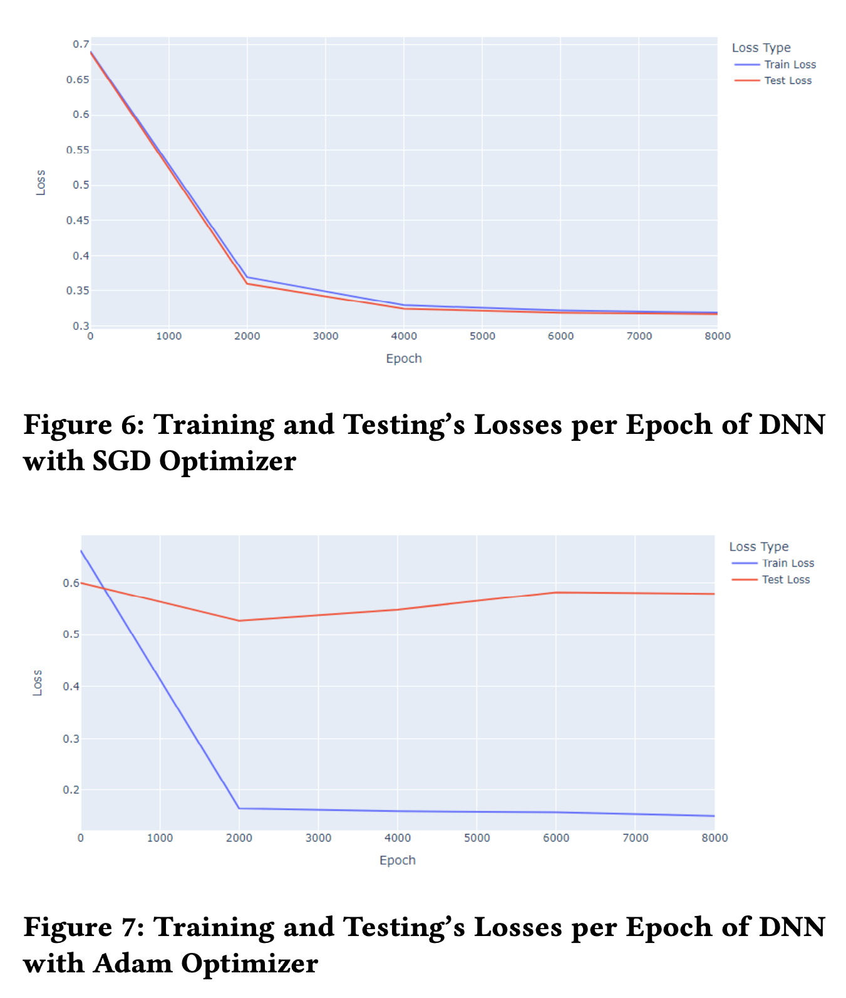
Optimization for DNN
01
SGD's Advantage
Navigation & Convergence in Moderate-Sized Datasets"
02
Leveraging
Mini-Batches
How SGD Enhances Solution Space Exploration
03
Moderate Dimensionality& SGD’s Superior Performance
Perfect Match
Notes:
In our research, we tested the efficiency of two optimization algorithms, Adam and Stochastic Gradient Descent (SGD), on the Adult Census Income dataset. The results favored SGD for its higher classification accuracy, mainly due to three reasons:
1. Our moderately-sized dataset helped SGD navigate the parameter space more effectively and converge to an optimal solution.
2. SGD's approach of updating parameters using mini-batches of data could have enhanced its exploration of the solution space.
3. The dataset's moderate dimensionality, combined with SGD's aptness for such scenarios, likely boosted its superior performance.

Slide 10
Refrences
“Adult census income,” kaggle, https://www.kaggle.com/datasets/uciml/adult- census- income?resource=download.
“Handling missing data,” scikit-learn documentation, 2023, https://scikit-learn. org/stable/modules/impute.html.
D. Omidvar, N. Tavakolian, N. Naseri, and S. H. Hosseini, “Project github,” https: //github.com/dinaomidvartehrani/Applied- AI- .git.
“Resampling methods,” scikit-learn documentation, 2023, https://scikit-learn. org/stable/modules/classes.html#module- sklearn.utils.
J. Brownlee, “Why one-hot encode data in machine learning?” 2020, https://machinelearningmastery.com/why-one-hot-encode-data-in-machine- learning/.

